Slide 1
ITEM - First Progress meeting
Prague, June 18, 2019
Prof. Ivan Chorbev, PhD

Slide 3

Who is Using Moodle?
In the higher education market in the United States, Moodle was for a time the second largest provider with 23% market share in 2013 (following Blackboard (41%), Desire2Learn (11%), and Instructure).
However, by 2017 Moodle had dropped to the third largest provider, due in part to increased adoption of Instructure's Canvas platform. In March 2016 Blackboard became an official Moodle par
There are 106686 currently active sites that have registered from 226 countries. (2019) (http://moodle.org/sites).
Moodle is an ideal online learning solution for:
K-12 Schools
Colleges
Universities
Governmental Agencies
Businesses
Trade Associations
Hospitals
Libraries
Employment Agencies
"My first live class just ended and it was a tremendous success, both in the behavior of the program and the quality and longevity of my participants. Moodle has been terrific to work with. Somehow it doesn't seem to be as tedious to work with as other courseware programs such as Blackboard and WebCT."
- Paula Edmiston, Trainer

Slide 4
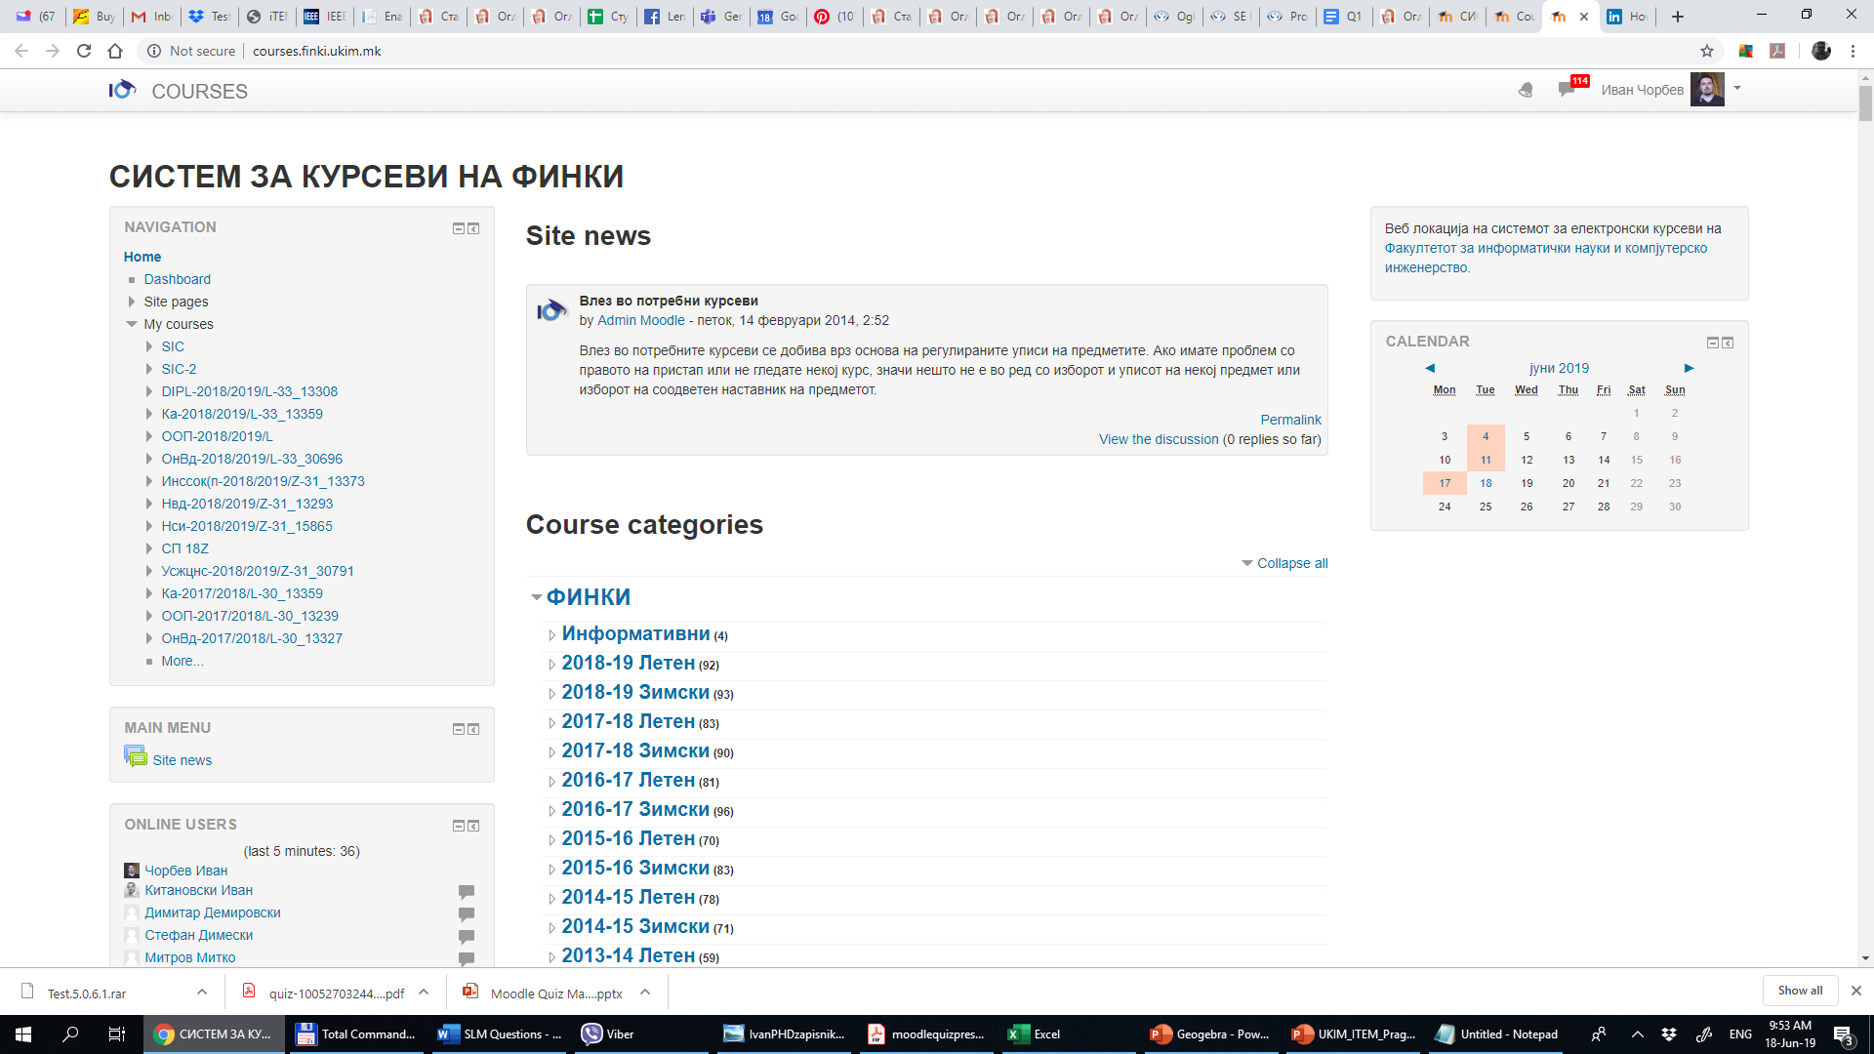

Introducing...... Moodle!
Moodle is an alternative to proprietary commercial online learning solutions, and is distributed free under open source licensing.
An organization has complete access to the source code and can make changes if needed. Moodle’s modular design makes it easy to create new courses, adding content that will engage learners.
modular object-oriented dynamic learning environment
Moodle’s intuitive interface makes it easy for instructors to create courses. Students require only basic browser skills to begin learning.

Slide 5
Introduction
Moodle is modular. We can develop if necessary or use one of the available plugins for the assessment of users, teachers and tutors to track the progress of the students and define pass or fail measures
Moodle has support for iOS and Android devices which cover most of the available tablets and mobile devices OS’s
Moodle has all the metrics and activities logged. They can later be analyzed and evaluated
Moodle has integrated tests and security measures. We actively use it in FCSE’s exams for student evaluation and testing and it also has an easy to use and customize system for grading.

Slide 6

Moodle Architecture
Activities are at the heart of a course management system.
Moodle was designed by an educator and computer scientist, with “social constructionist” principles in mind. “Constructionism asserts that learning is particularly effective when constructing something for others to experience. This can be anything from a spoken sentence or an internet posting, to more complex artifacts like a painting, a house or a software package.
The concept of social constructivism extends the above ideas into a social group constructing things for one another, collaboratively creating a small culture of shared artifacts with shared meanings.
When one is immersed within a culture like this, one is learning all the time about how to be a part of that culture, on many levels.”
Martin Dougiamas
Creator & Lead Developer

Slide 7

Promoting Learner Involvement
“A constructivist perspective views learners as actively engaged in making meaning, and teaching with that approach looks for what students can analyze, investigate, collaborate, share, build and generate based on what they already know, rather than what facts, skills, and processes they can parrot. Some of the tenets of constructivism in pedagogical terms include:”
Students come to class with an established world-view, formed by
years of prior experience and learning.
Even as it evolves, a student’s world-view filters all experiences and
affects their interpretations of observations.
For students to change their world-view requires work.
Students learn from each other as well as the teacher.
Students learn better by doing.
Allowing and creating opportunities for all to have a voice promotes
the construction of new ideas.

Slide 8
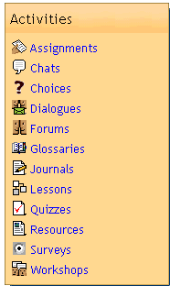
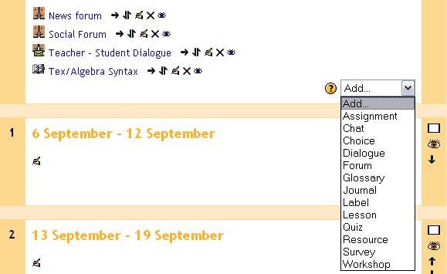
Getting Started
Moodle has a “modular” design so adding the Activities that form a course is a simple process:
1. Course creation privileges are assigned to the teacher.
2. Select from one of three course layout; Topic, Weekly
or Social format.
3. Click “Turn editing on” within the blank course template.
4. Create the course!
With editing turned on, the course creator can now Add activities from an intuitive drop-down list of module plug-in features.

Slide 9
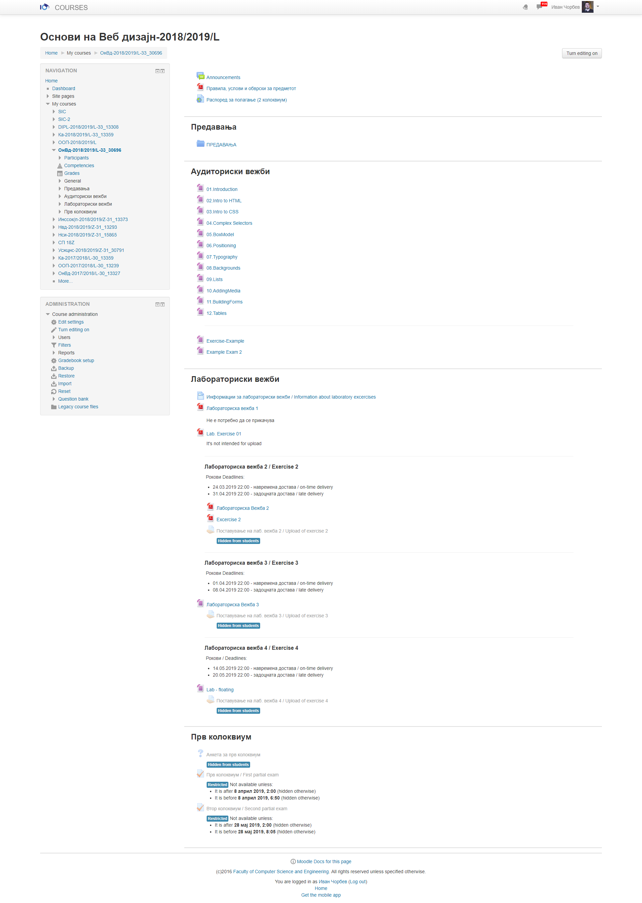
Thematic course

Slide 11
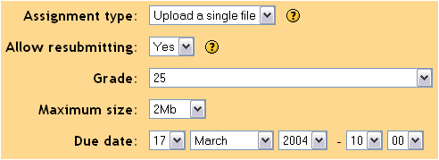

Course Management Features - Modules
Assignment
Used to assign online or offline tasks; learners can submit tasks in any file format (e.g. MS Office, PDF, image, a/v etc.).
Chat
Allows real-time synchronous communication by learners.
Choice
Instructors create a question and a number
of choices for learners; results are posted
for learners to view. Use this module to
do quick surveys on subject matter.
Dialogue
Property screens guide instructor through setup when creating a new Assignment
Assignment activity can require the learner to upload a completed project.
Allows for one-to-one asynchronous message exchange between instructor and learner, or learner to learner.

Slide 12
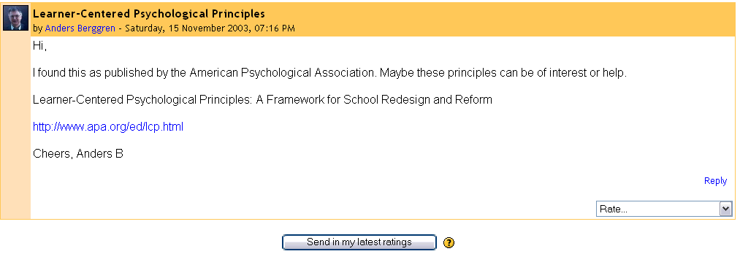
Course Management Features - Modules
Forums
Threaded discussion boards for asynchronous group exchange on shared subject matter. Participation in forums can be an integral part of the learning experience, helping students define and evolve their understanding of subject matter.
Students can Rate a forum post, based on Scales set up by the course creator

Slide 13
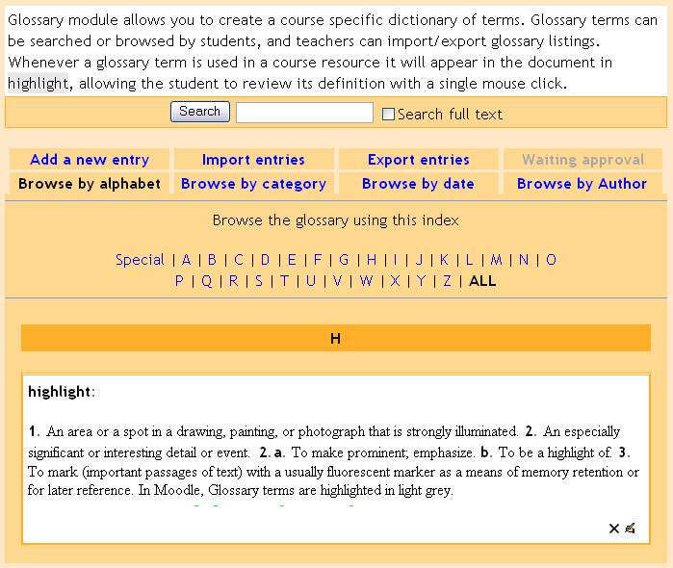
Course Management Features - Modules
Glossary
Create a glossary of terms used in a course. Has display format options including entry list, encyclopedia, FAQ, dictionary style and more.
Journal
Learners reflect, record and revise ideas.
Label
Add descriptions with images in any area of the course homepage.
Lesson
Allows instructor to create and manage a set of linked "Pages". Each page can end with a question. The student chooses one answer from a set of answers and either goes forward, backward or stays in the same place in the lesson.
Glossary terms appear in highlight within all activity resources. Moodle includes its own site search engine.

Slide 14
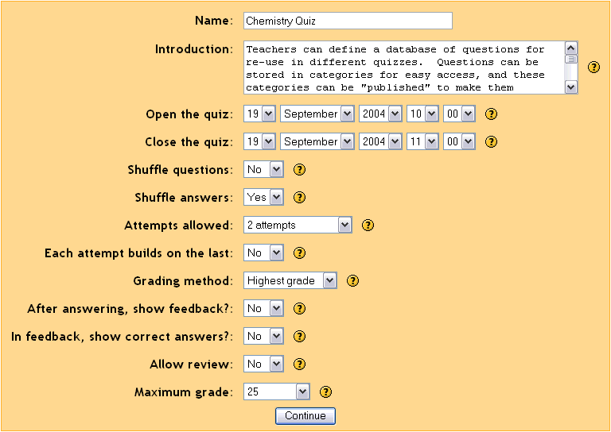
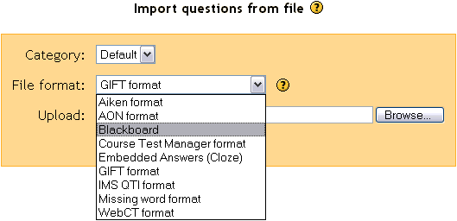
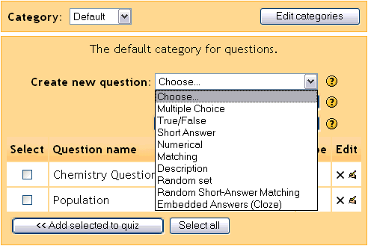
Course Management Features - Modules
Quiz
Create all the familiar forms of assessment including true-false, multiple choice, short answer, matching question, random questions, numerical questions, embedded answer questions with descriptive text and graphics.
Instructors have granular control in defining course assessments, and can import quiz questions from popular formats like Blackboard, IMS QTI and WebCT. Moodle also supports embedding audio into a quiz.

Slide 15
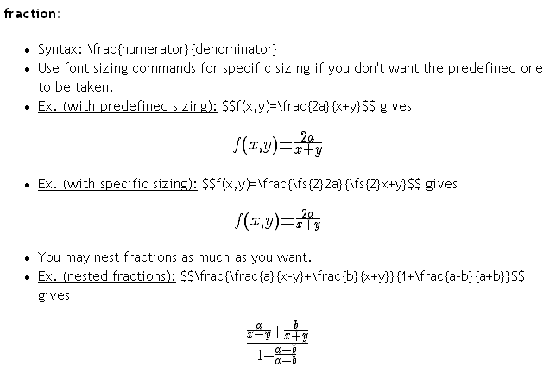
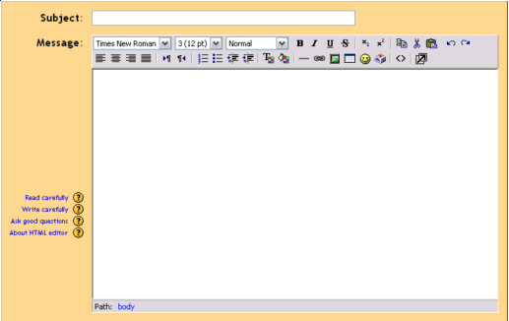
Course Management Features - Modules
Resource
The primary tool for bringing content into a course; may be plain text, uploaded files, links to the web, Wiki or Rich Text (Moodle has built-in text editors) or a bibliography type reference.
Survey
This module aids an instructor in making online classes more effective by offering a variety of surveys (COLLES, ATTLS), including critical incident sampling.
Workshop
An activity for peer assessment of documents (Word, PP etc.) that students submit online. Participants can assess each other’s project. Teacher makes final student assessment, and can control opening and closing periods.
Moodle supports adding math expressions to a Resource activity, using the built-in HTML editor

Slide 16

Learner Management Features
Creating learning content is only part of what a good course management system (CMS) must do. The CMS must manage learners in a variety of ways. Learner management includes:
  Access to information about learners in a course.
  Ability to segment participants into groups.
  Site, course and user calendar event scheduling.
  And so much more…e.g. applying scales to different learner activities, managing grades, tracking user access logs and uploading external files for use within the course etc.

Slide 17
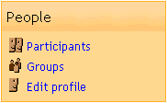
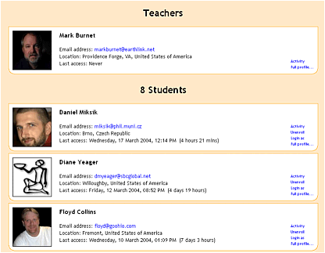
Learner Management Features – Participants
One click and you can view activity from all participants enrolled in the course. Learners create a personal profile that can include a picture, helping connect students socially in the online learning community.
Learners complete a personal profile
page that helps build the online learning community. Adding a picture and
details to the profile creates a social
connection.

Slide 18
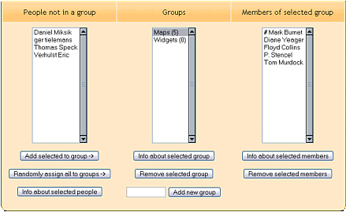
Learner Management Features - Groups
Assigning learners to a group is a common practice in education and business. Moodle allows the course instructor to easily create group categories, and determine how members will interact with each other and within various activities.
Creating distinct group names is easy. Learners and teachers are assigned to a group by clicking a single button.

Slide 19
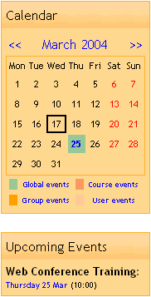
Learner Management Features - Calendar
Keeping a calendar of events is important to both the learner and course instructor. Events can be created for different categories, including:
Global events that appear in all courses (system admin).
Course events set by an instructor.
Group events set by instructor relative only to a group.
User events set by learner (e.g. due dates, personal etc.).
Upcoming Events appear on the course homepage, alerting the learner across all courses they are enrolled in of different category events. Alerts are color-coded by category.

Slide 20
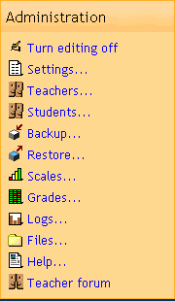
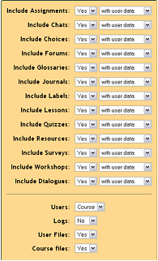
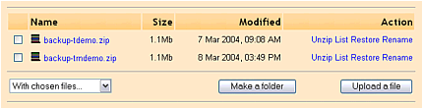
Learner Management Features – Admin
The Administration control panel puts all important learner management functions a single click away. Teachers and Students can be manually enrolled or removed from a course. Configuration of course Backup and Restore is achieved on a single screen.
Restoring an existing course or Uploading a file archive from storage is accomplished with a single mouse click. Moodle makes it easy to re-use and share courses with other teachers. Backup can include or exclude student files and course data.

Slide 21
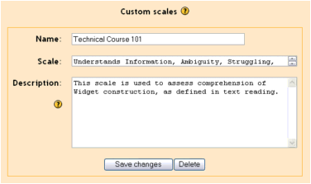
Learner Management Features - Scales
Instructors may define custom Scales to be used for grading Forums, Assignments and Journals. Standard scales include assigning a value from 1-100% for each submission (or no grade), and indicating whether the learner was demonstrating one of three characteristics in the activity:
Shows mostly CONNECTED knowing.
Shows mostly SEPARATE knowing.
Equally separate and connected.
Custom scales allow the instructor to fine tune their grading for specific content. Easily create several types of scales, and connect them with different activities you Add to the course.

Slide 22
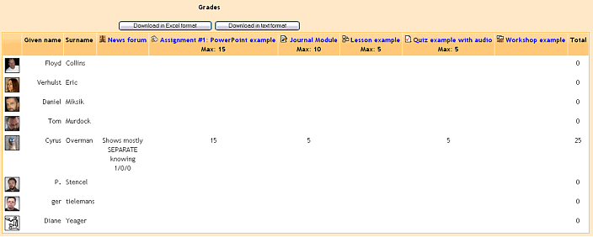
Learner Management Features - Grades
The Grades feature in Moodle provides a quick view of all Forum, Assignment, Journal, Quiz, Lesson and Workshop grades. The grading scale applied to a learner’s submission is shown, along with a cumulative total, on a single page.
Grades can be downloaded in Excel or plain text for inclusion into an existing electronic gradebook

Slide 23
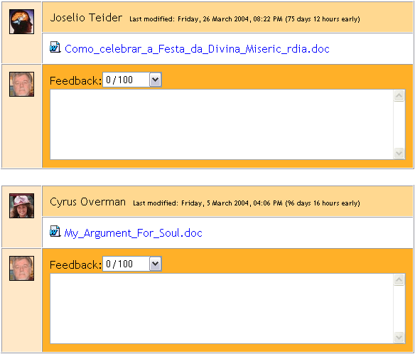
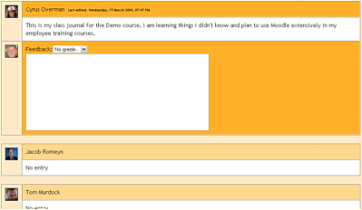
Learner Management Features - Grades
Viewing Assignment and Journal submissions, and adding Grades and comments, are done from a single page that displays all enrolled students.
Managing student submissions are done from one central screen. This cuts down on the time it takes to assess many students work.

Slide 24
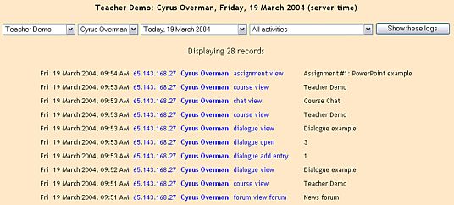
Learner Management Features - Logs
Monitor when and what course resources the learner has accessed. Moodle's Logs provide detailed learner activity.
Logs pin-point where a student is within coursework. Easily locate specific course, student, date and module activity access.

Slide 25
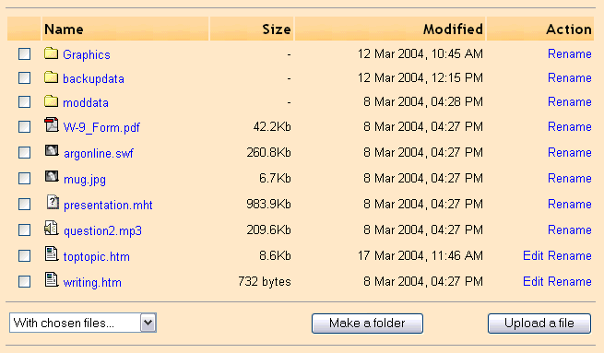
Learner Management Features - Files
Centrally locate all course resources within the Files area of Moodle so they are available when creating new activities.
Files storage area resembles your computer, making it easy to add, move, zip and delete resources.

Slide 26

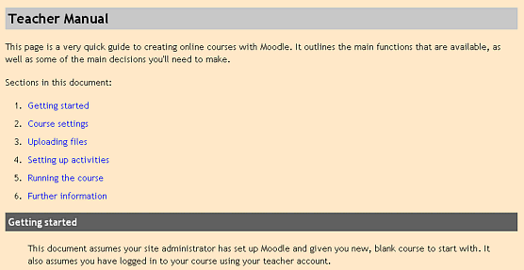
Learner Management Features - Help
An extensive Moodle Help file is a button click away. Courses include a Teacher only forum, where colleagues can collaborate on tasks and share ideas.
Moodle's built in Teacher Manual provides step-by-step instructions
on all aspects of course and learner management

Slide 27

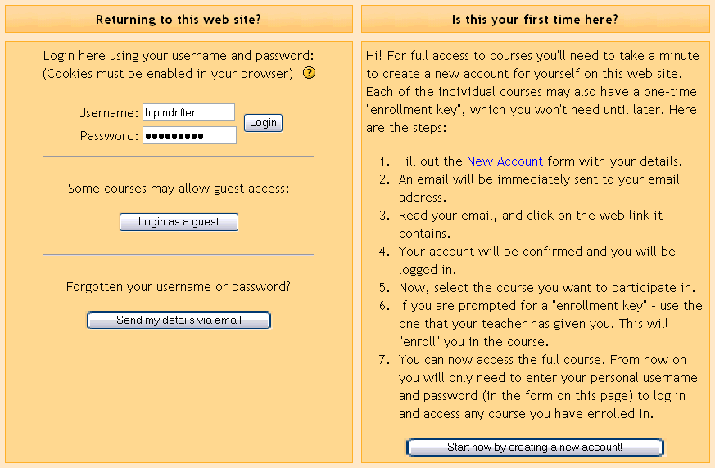

Learner Experience - Login
Learners find it easy to navigate a Moodle course homepage in their browser; intuitive “breadcrumb” links are always present. Login occurs on a familiar screen. Initial account set up may be handled by the learner or administrator.
Navigation bar provides breadcrumb links
from course homepage to activities
Moodle's has its own authentication system, but will integrate with an external database, POP3, IMAP, LDAP or NNTP, allowing domain wide login.

Slide 28

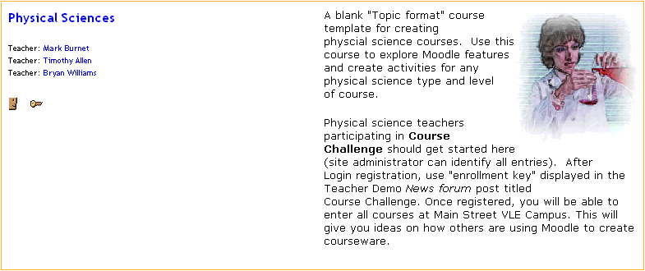
Learner Experience – Enrollment Keys
Instructors can require an “enrollment key” to allow participation in a class. Enrollment keys are provided to learners separately from the log in process. Courses requiring an enrollment key are indicated in “Course categories” description.
Course category displays descriptions of each course. Symbols on description page indicate when a course requires an enrollment key and allows Guest entry. Students see a list of courses they are enrolled in (My courses) on site homepage after login.

Slide 29
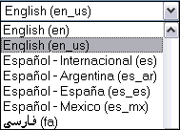
Learner Experience – 24/7/365 Anywhere!
Learners can login any time, anywhere to interact with coursework, and can specify the Time Zone and Language they wish to use. Moodle has interface support for 34 languages.
Learners can select from 34 languages at Login

Slide 30
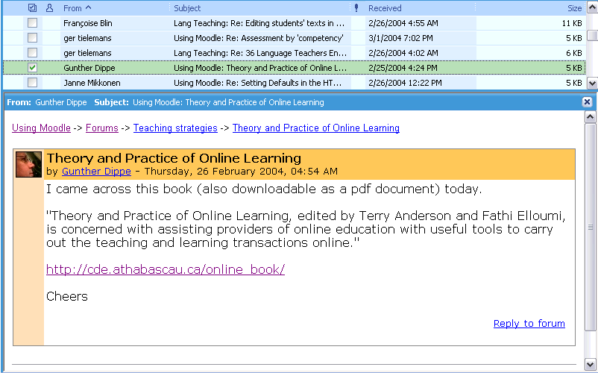
Learner Experience – E-Mail Notification
When learners “subscribe” to forums they are notified by e-mail of new postings. Additionally, instructors can set e-mail notification for private Dialogues.
Rich text e-mail is sent to each learner “subscribed” to different Forums. Instructors can set private Dialogues to e-mail notification that comments have been added.

Slide 31
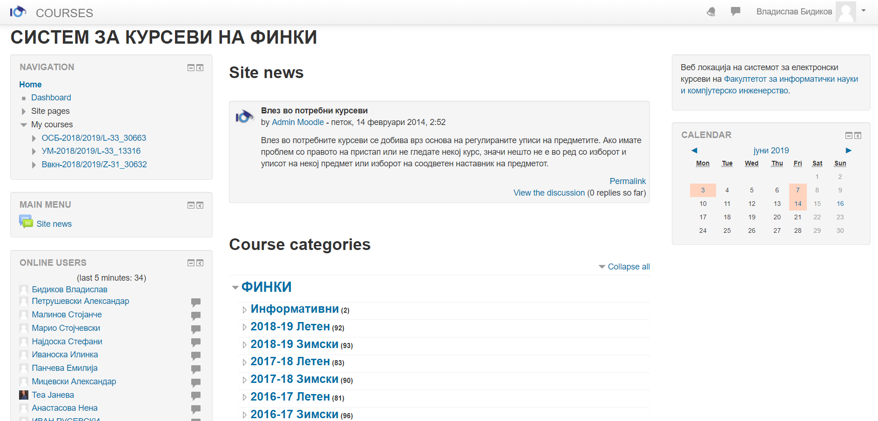
Implementation of Moodle @ FCSE (technical details)
FCSE uses a standard Moodle installation - Additional features have been customized in order to ease the process:
User management is based on a central Active Directory system with CAS
Course access is managed by the University information system – iKnow
Subjects are grouped by school year for easy navigation
Access from Computer labs is via separate network
Safe Browser has been implemented since Quiz is the most used way of making exams
Computer Lab Firewall

Slide 32
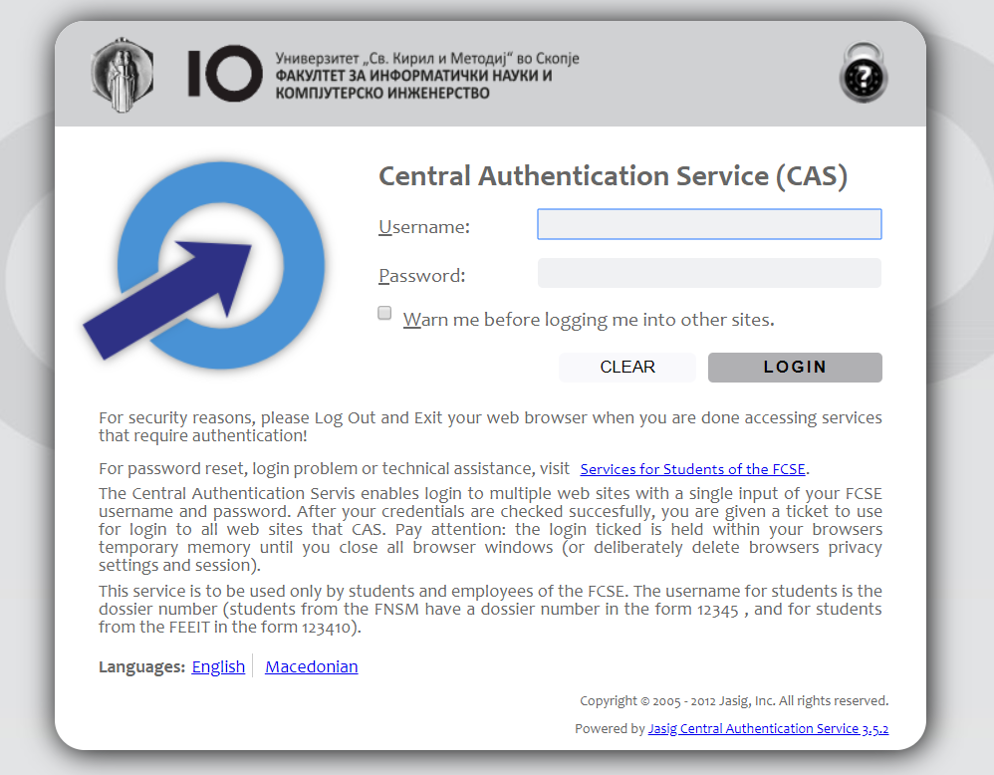
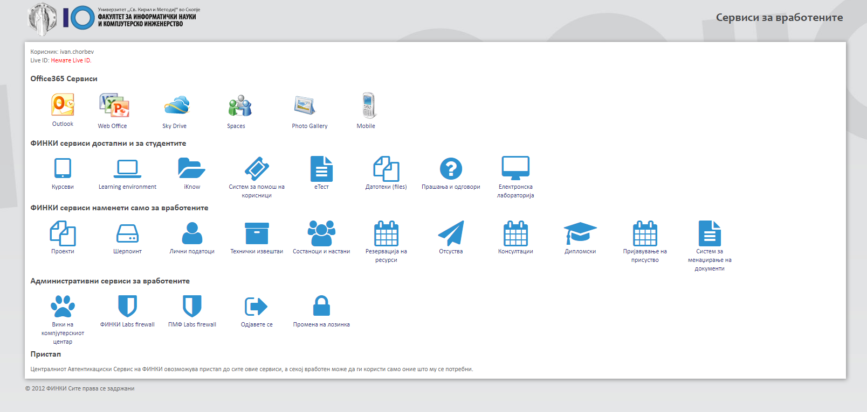
Central login via Active Directory & CAS
All FCSE services both for Staff & Students use the same CAS login system which increases security and eases management

Slide 33
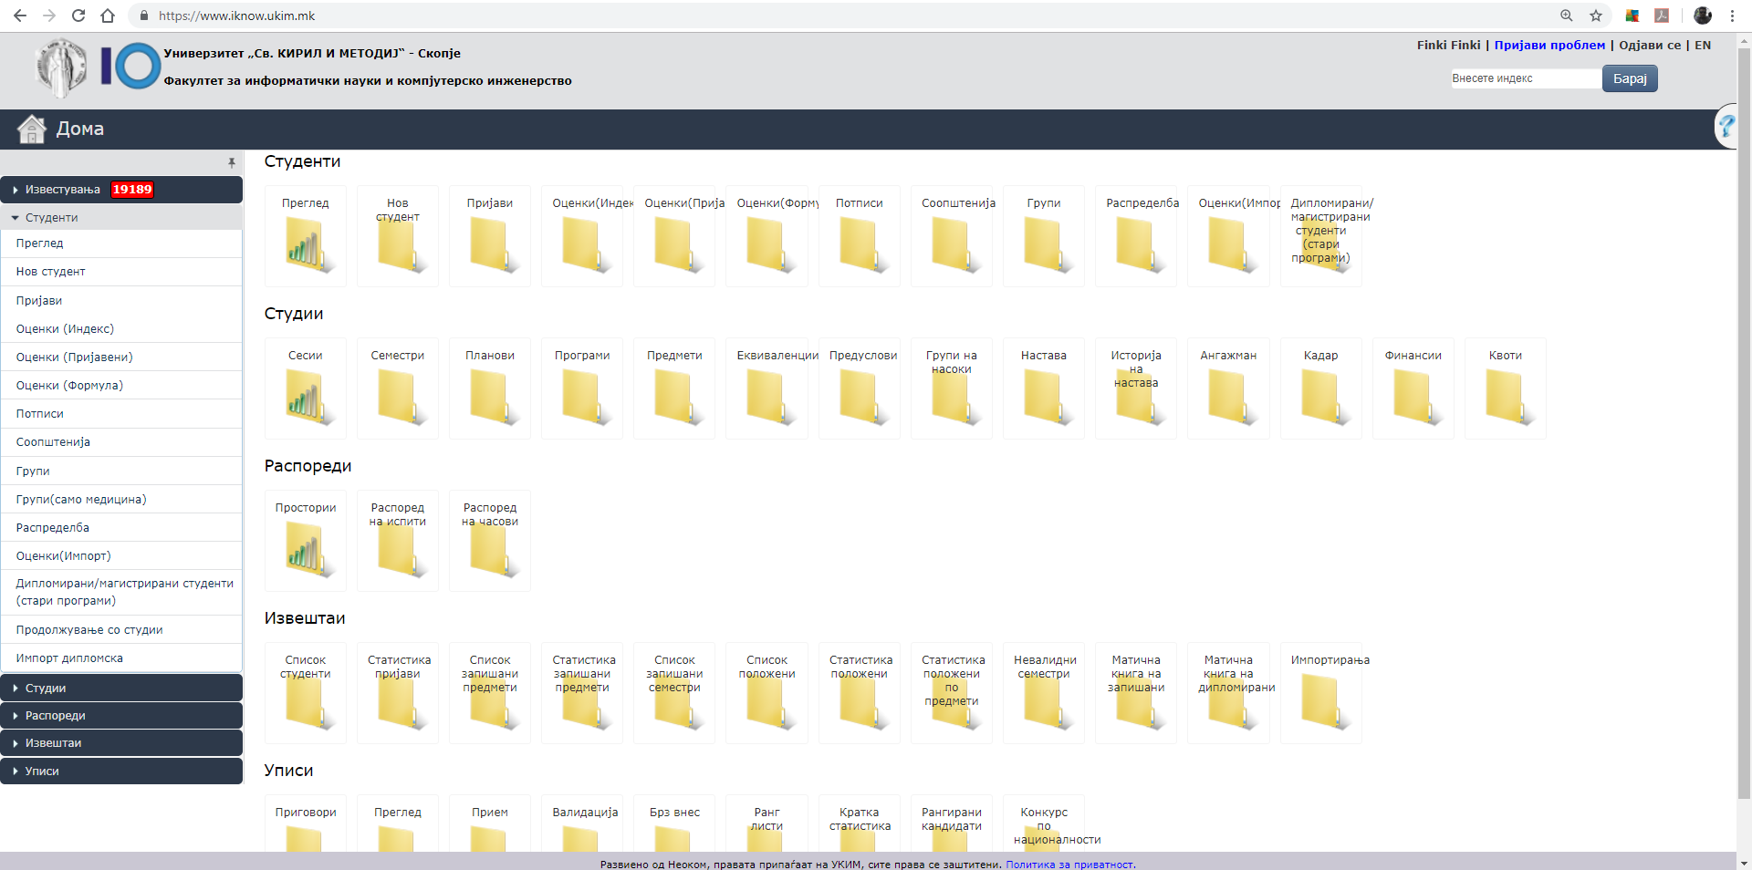
University information system – iKnow
New course provisions process:
Teacher is appointed to a course for the semester by the deans office
Teacher requests online course creation via iKnow (also several teachers can share a course)
After the Moodle course is created, students which have already enrolled the course in iKnow automatically enroll in the Moodle course
Sync every hour
  PostgreSQL
Join several courses
Groups in a course
Language groups
Stavi sliki so predmeti I student od iKnow I
obavezno od toa dialogot za kreiranje kurs vo moodle

Slide 34
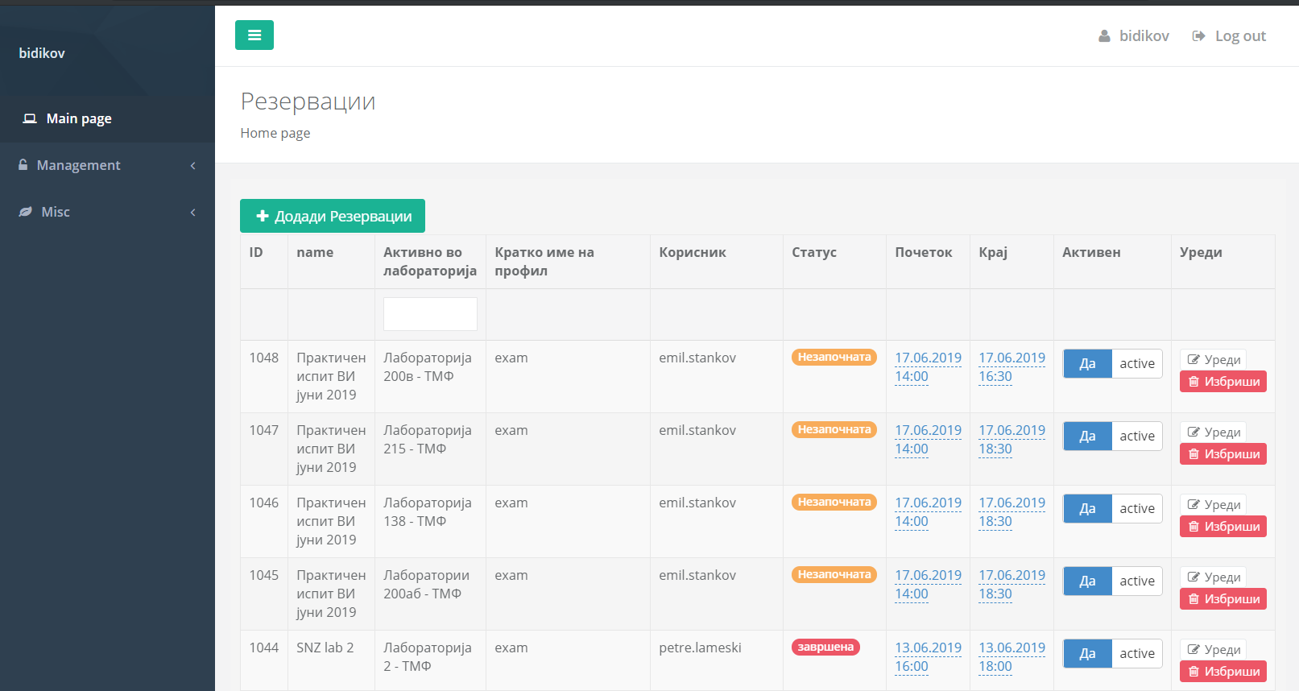
Computer Lab Firewall
Self service firewall for Computer Labs
Staff can schedule the firewall function per course and per lab
The system automatically activates and deactivated the firewall based on the schedule
No need for System Administrators intervention – staff users manage everything themselves.

Slide 35
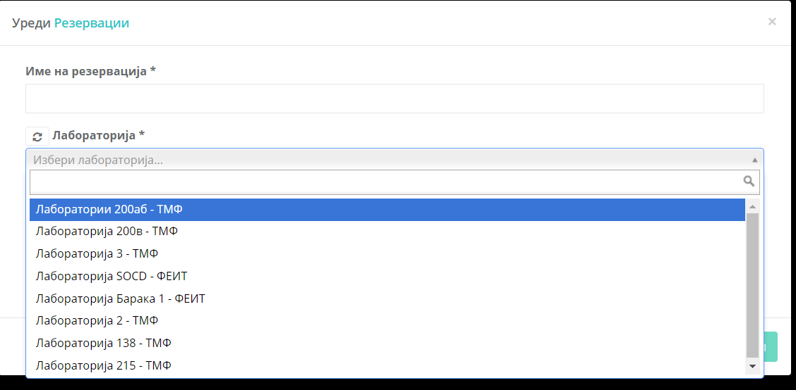
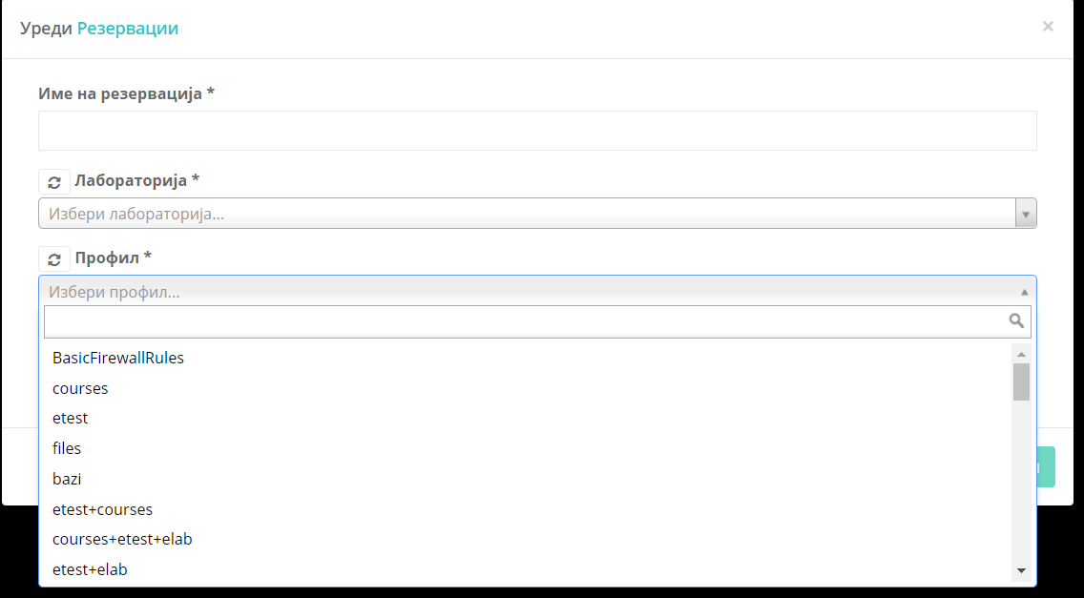
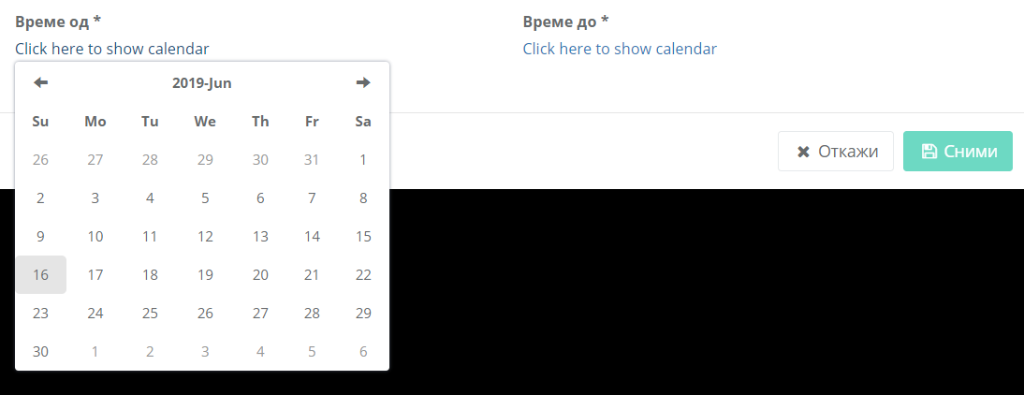
Computer Lab Firewall (2)

Slide 36
Moodle Quizzes

Slide 37
Moodle Quiz Question Types

Slide 38
Calculation Questions

Slide 39
Calculated Multichoice Questions

Slide 40
Description

Slide 41
Essay Question

Slide 42
Matching Question

Slide 43
Cloze Question

Slide 44
Multi-Choice Question

Slide 45
Short Answer Question

Slide 46
Numerical Question

Slide 47
True/False Question

Slide 48
More question types

Slide 49
Drag – Drop into text

Slide 50
Pattern Match

Slide 51
Tips

Slide 52
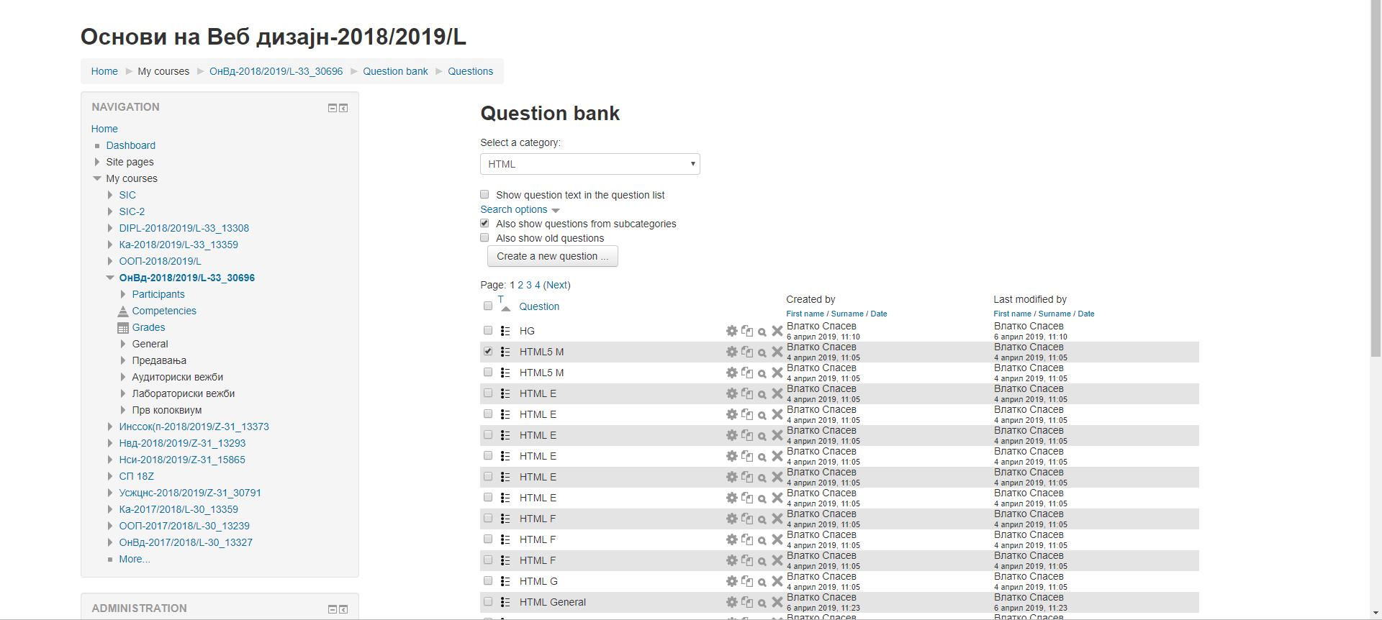
Question bank

Slide 53
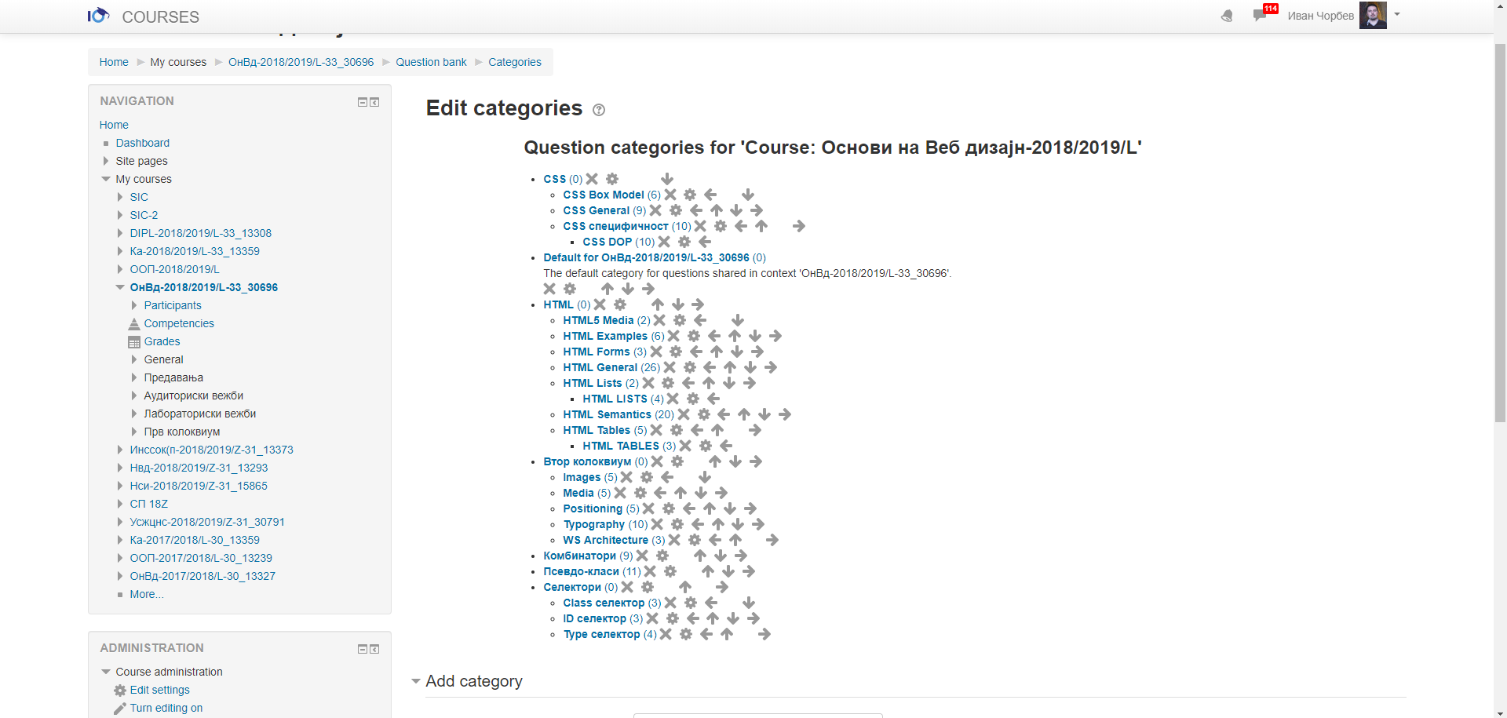
Question categories

Slide 55

Questions

