Slide 1
1st Progress Meeting iTEM Project
Visit us in: http://item.teicrete.gr

Slide 2
1st Progress Meeting
Insert the Group Photo!!!!

Slide 3
iTEM Key Principles

Slide 4
iTEM Key Principles

Slide 5
iTEM Key Principles

Slide 6
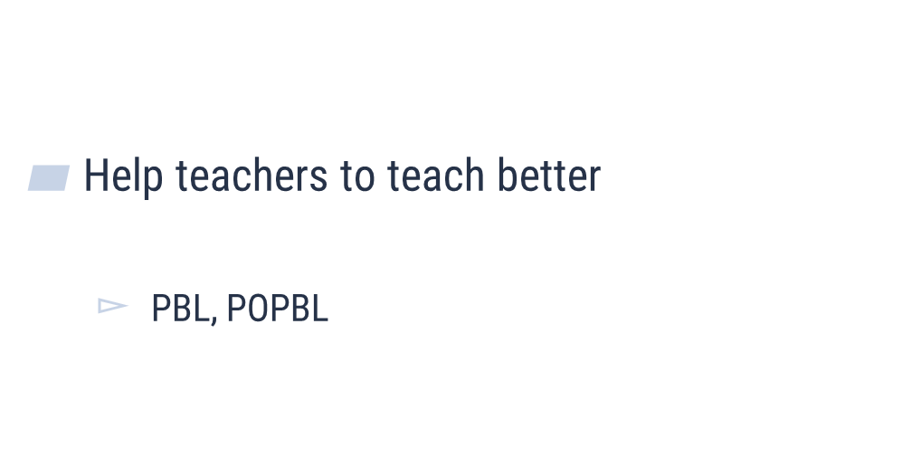
iTEM Key Principles

Slide 7
iTEM Key Principles

Slide 8
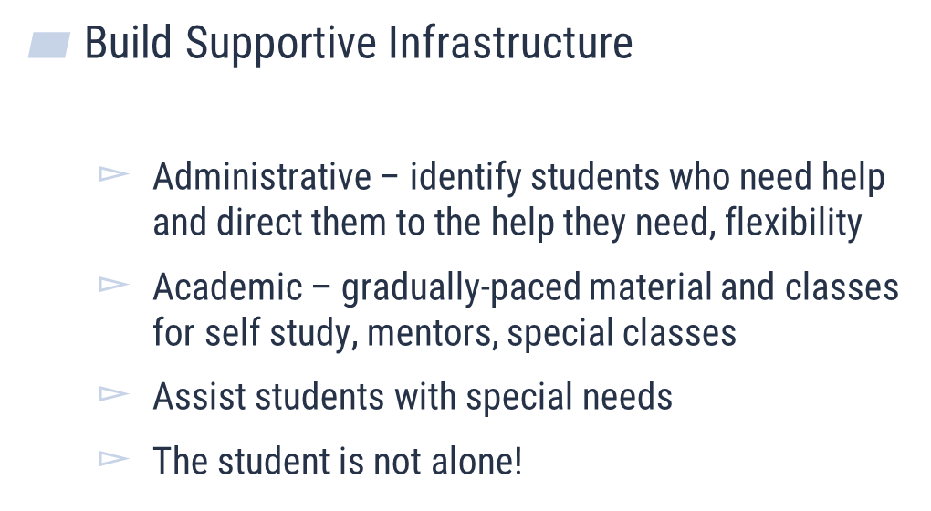
iTEM Key Principles

Slide 9
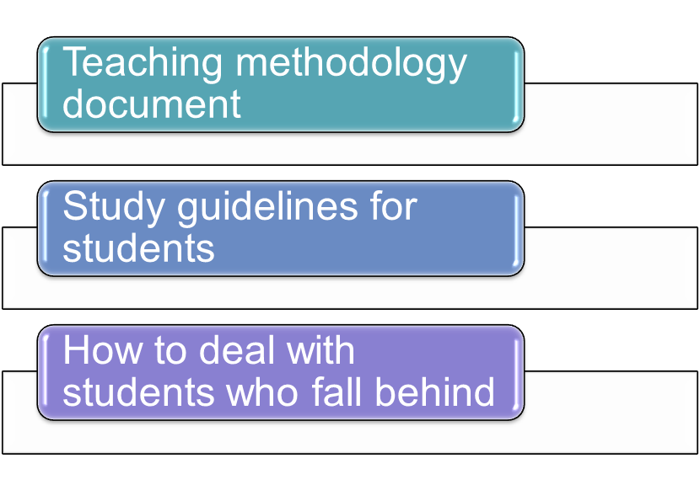
iTEM Key Principles

Slide 10
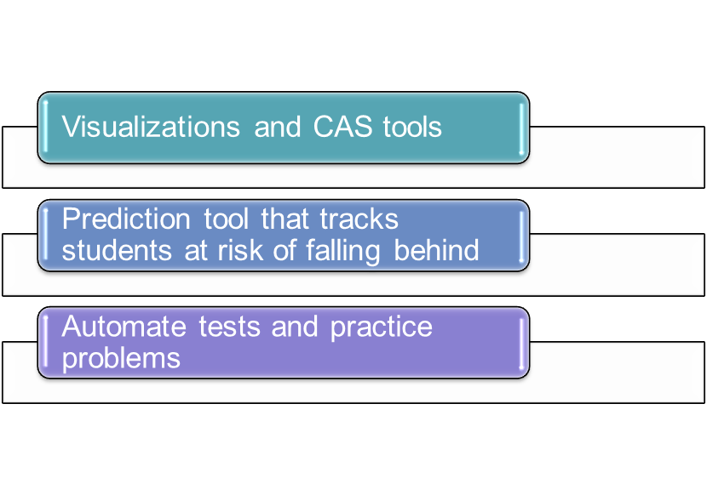
iTEM Key Principles

Slide 11
Work Package One: Preparation Lead Organization: NUUz (Uzbekistan)

Slide 12
Tasks Set Up in the Kick off Meeting
What was decided in CRETE’s meeting:

Slide 13
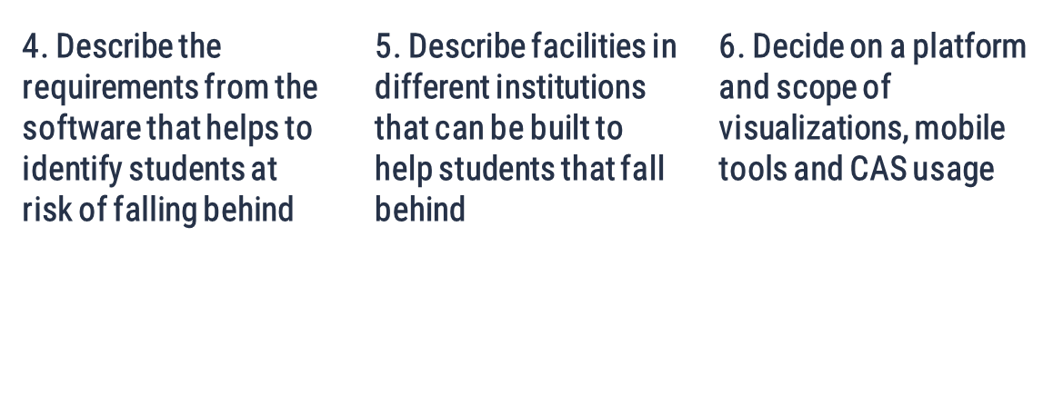
Tasks Set Up in the Kick off Meeting
What was decided in CRETE’s meeting:

Slide 14
Tasks Set Up in the Kick off Meeting
Presentation by the Working Groups / Decisions to be Taken:
Presenter: Team One Leader HAC – Laure

Slide 15
Tasks Set Up in the Kick off Meeting
Presentation by the Working Groups / Decisions to be Taken:
Presenter: Team Two Leader HIT & HMU – Nissim & Kostas

Slide 16
Tasks Set Up in the Kick off Meeting
Presentation by the Working Groups / Decisions to be Taken:
Presenter: Team Three Leader FINKI – Ivan

Slide 17
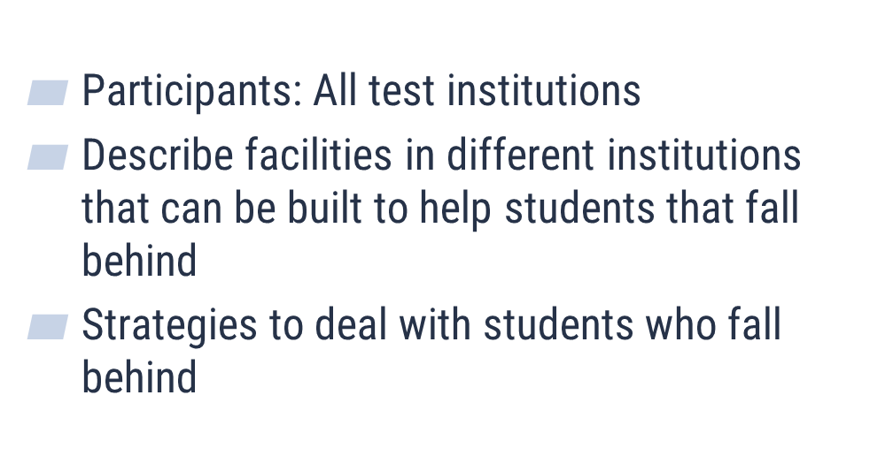
Tasks Set Up in the Kick off Meeting
Presentation by the Working Groups / Decisions to be Taken:
Presenter: Team Four Leader CVUT – Eva

Slide 18
Tasks Set Up in the Kick off Meeting
Presentation by the Working Groups / Decisions to be Taken:
Presenter: Team Five Leader UC – Armend

Slide 19
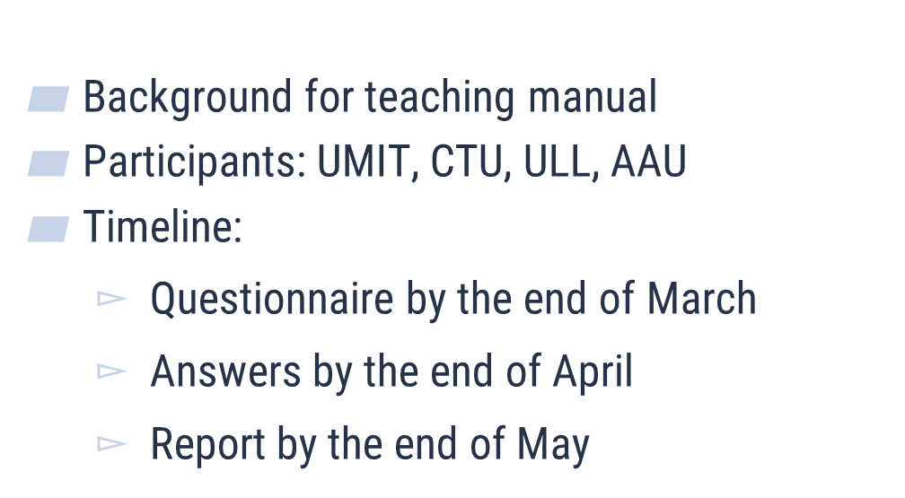
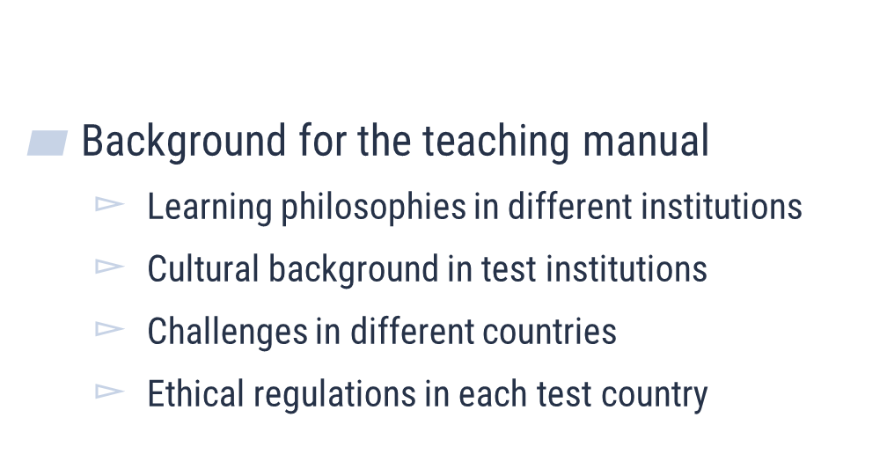
Tasks Set Up in the Kick off Meeting
Presentation by the Working Groups / Decisions to be Taken:
Presenter: Team SIX Leader UMIT– Elske

Slide 20
Tasks Set Up in the Kick off Meeting
Presentation by the Working Groups / Decisions to be Taken:
Presenter: Team Seven Leader ULL– Rodrigo

Slide 21
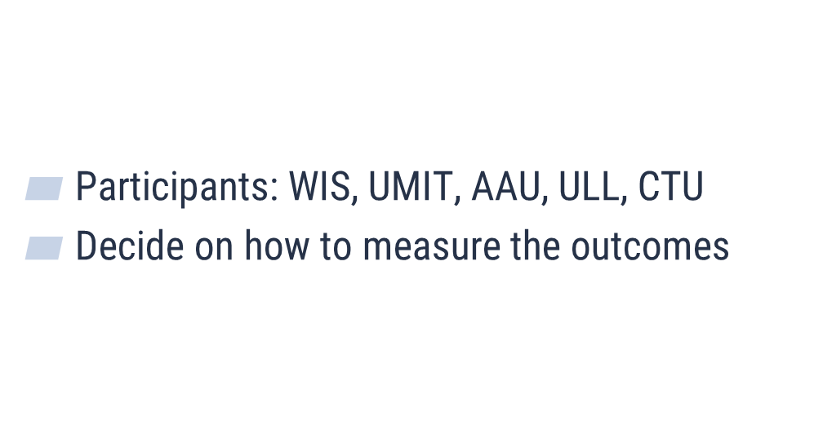
Tasks Set Up in the Kick off Meeting
Presentation by the Working Groups / Decisions to be Taken:
Presenter: Team Eight Leader WIS– Ronnie

Slide 22
Deliverable 1.1
Deliverable 1.1: Document Describing the topics to be integrated into Linear Algebra & Calculus I – 01/04/2019
Example from HMU from Lasers (Kostas)
Example from HIT (Nissim)

Slide 23
Deliverable 1.1
Deliverable 1.2: Document describing the methodology of measuring the baseline – 01/04/2019
Measuring the baseline of math knowledge & student’s attitudes towards maths
Describe the metrics & mode of operation (how to measure)

Slide 24
Deliverable 1.3
Deliverable 1.3: Requirements for a tool that early identifies students at risk of falling behind – 01/04/2019
Frequent On line Assessments
Based on the Asynchronous Platform each test Institution employs e.g. Moodle is suggested because of the UKIM experience in using it

Slide 25
Work Package Two: Development Lead Organization: HIT (Israel)

Slide 26
Deliverable 2.1
Deliverable 2.1: Educational Material & Teaching Guide Manual – 01/04/2020
Lecture Notes in Linear Algebra and Calculus I enriched with real life problems and applications from other scientific topics
Construction of a teaching manual that describes (a) how to motivate students; (b) secure feedback to monitor their progress; and (c) establish extra help to those one that fell back
Each real life topic should be clearly linked with definitions from Linear Algebra and Calculus
Each Test Institution should develop four such examples

Slide 27
Deliverable 2.1
Deadline: 14/12/2019

Slide 28
Deliverable 2.2
Deliverable 2.2: Training Seminars in innovative teaching methodologies & produced educational material for Academics in Maths (and in STEM in general) – 31/08/2021
Targeted training in PBL and POBL teaching methods – provided by AAU
Make students work independently
Enhance team working spirits among students to address a problem
Introduce problems from Industry to be challenged using fundamental Math tools & knowledge
Help them to use ICT tools during lecture and studying sessions

Slide 29
Deliverable 2.2
Teaching Material: CVUT, AAU, KSU and ULL prepare a document & videos that provide tips to MATH teachers how to address the aforementioned priorities
1st Workshop (two days) in AAU (Copenhagen) during October – November 2019
Suggest dates – open a doodle right away

Slide 30
Deliverable 2.3
Automating Tests: (Deadline by the end of December 2019)
Generate a pool of questions that will be grouped in eight test sessions
It will be accessed through classroom computers or mobile tools (e.g. mobile phones)
CVUT, UKIM, KEEI and TUIT are the responsible partners to: (a) generate these questions & tests, and (b) intergrade them through a Moodle Platform (or the e-class platform each University is using)
All the test Institutions will use / host these tests

Slide 31
Deliverable 2.4
Building Visualizations and CAS Systems: (Deadline by the end of August 2021)
The MATHEMATICA software will be ordered and be purchased in Kosovo – The bureaucracy has been completed / Funds from HIT to HMU have been transferred / Funds from HMU to UC for Mathematica still pending
ULL, KSU will advice UOM, HAC, UP and NUUz how to develop visualizations (a) for class purposes; (b) for student’s homework/projects
By the end of June 2019, the software to be used for visualization and CAS should be identified – see Rodrigo Task & email
By the beginning of 2020 develop the visualizations and propose the rest of the Test Institutions how to use them

Slide 32
Deliverable 2.4
Attention: by the middle of December 2019

Slide 33
Deliverable 2.5
Deliverable 2.5: Development & Training in the use of software that identifies students who fall behind (31/08/2021)
UMIT has developed an expertise in learning analytics based on the digital trail student leave, suing online tests will uploaded onto the Moodle platform (UKIM)
The requirements, design and implementation, testing have been discussed by working group five (Armend)
The 1st prototype should be ready by December 2019

Slide 34
Deliverable 2.6
Deliverable 2.6: Roll Out Events to test iTEM Techniques and Tools
To check out the efficiency of the proposed tools and materials two testing phases will take place: (2019-20) in HAC, UoM, TUIT and NUUz and (2020 – 2021) where all the test Institutions will apply the proposed tools and techniques

Slide 35
Deliverable 2.7
Deliverable 2.7: Intensive Courses for Students and Academics
1st IC in UMIT on July 2020
2nd IC in ULL on July 2021

Slide 36
Deliverable 2.8
Deliverable 2.8: How to Learn Mathematics
A manual with guidelines for students how to build their math background and skills using the tools and material generated during the iTEM project
Responsible Partners: CVUT and HIT under the consulting of ULL, WIS, KSU and AAU
Ready by: 31/09/2021

Slide 37
Deliverable 2.9
Deliverable 2.9: The iTEM Moodle Platfrom
All the generate material and tools will be uploaded in a modified (using the UMIT learning analytic tools) Moodle Platform
Responsible Partner: UKIM
Ready by 31/09/2021

Slide 38
Work Package Three: Quality Plan Leading Partners: WIS (Israel)

Slide 39
Deliverable 3.1
Deliverable 3.1: Survey Satisfaction with Math Teaching Delivery Techniques and Tools / Realisation of Math Potential and Motivation
All the test Institutions should run two surveys among their student’s communities prior to the application of the iTEM techniques & suggestions and after the 1st and 2nd pilot phases
Please check the HMU survey among its students (90 participants) / A similar one implemented by TUIT (Prof. Uzmanova)
The used questionnaire can be viewed in: https://forms.gle/oFUgDeCsSQwzX11K6

Slide 40
Deliverable 3.1
Hellenic Mediterranean University (Greece)
Survey among students have followed the courses in Linear Algebra and Calculus I

Slide 41
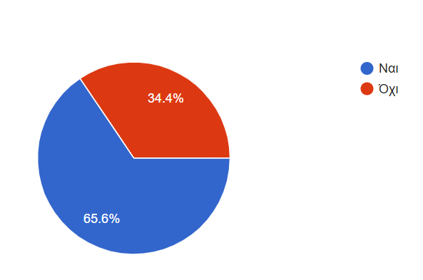
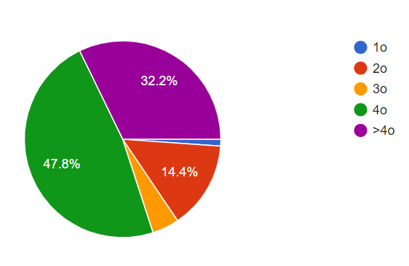
Deliverable 3.1
Level of Studies of the Respondent
Are you happy with the assigned teaching time ?

Slide 42
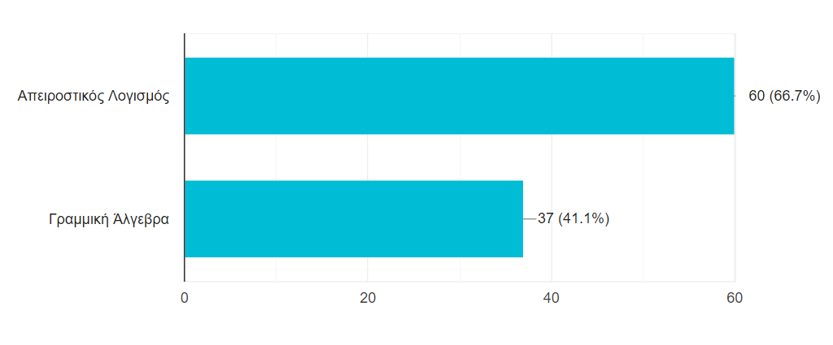
Deliverable 3.1
Which of the two modules you think necessitates improvement (more teaching time and introduce of CAT tools)

Slide 43
Deliverable 3.1
What are the difficulties you experience during the following of these two modules
Lack of knowledge of fundamentals
No provision of examples during the lecture time
Lack of motivation – More examples from real life should be provided
More teaching time is required (right now three hours of teaching is devoted)
More material should be uploaded online to provide more time to the students to study using their time as well
A lot of material to be covered within 12 weeks of lecturing
Limited engagement with the lecturer
The lecture sessions were very early in the morning

Slide 44
Deliverable 3.1
What solutions do you suggest ?
The lectures to take place not very early in the morning
To link the teaching of mathematics with the use of real life problems and examples from other technologies
To link mathematics with the rest of our studies
Use of mobile tools during the teaching and learning processes
More teaching time is requested
Establishment of help line for the students
More solved examples
Smaller student’s groups to be formed – better analogy between lecturer/students
Enrichment of the e-class documents

Slide 46
Deliverable 3.2
Hellenic Mediterranean University (Greece)
Survey among Math lecturers have taught the courses in Linear Algebra and Calculus I
https://forms.gle/x5c37rct2m8EDHSS9

Slide 47
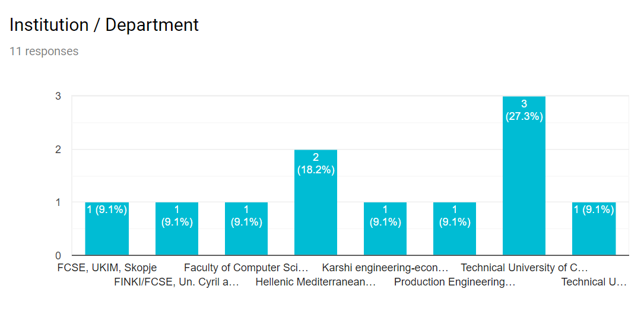
Deliverable 3.2
Eleven Teachers / Academics participated in the survey (is still on going)

Slide 48
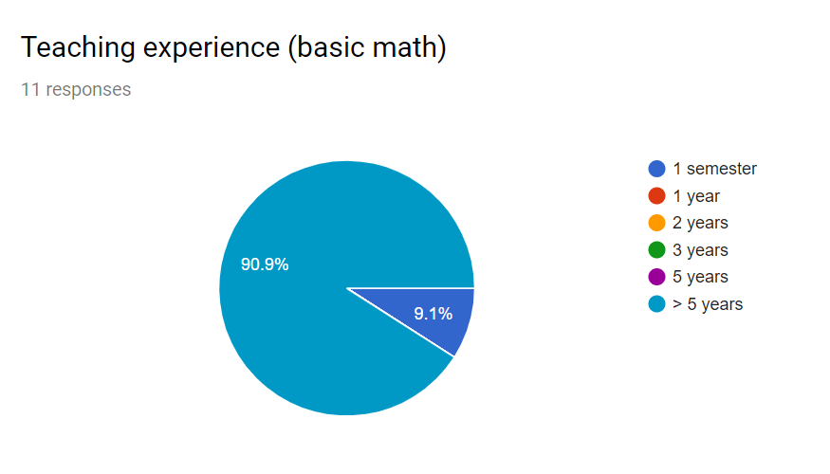
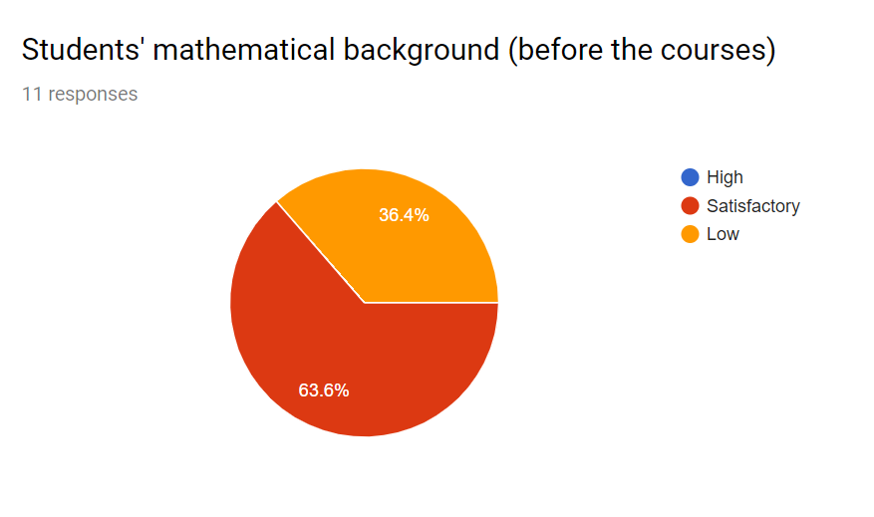
Deliverable 3.2
Experience in Teaching Linear Algebra and Calculus I

Slide 49
Deliverable 3.2
In case of low attendance (question above) please indicate possible reasons:
Low Motivation due to lack of previous knowledge
It is not obligatory to follow the lectures

Slide 50
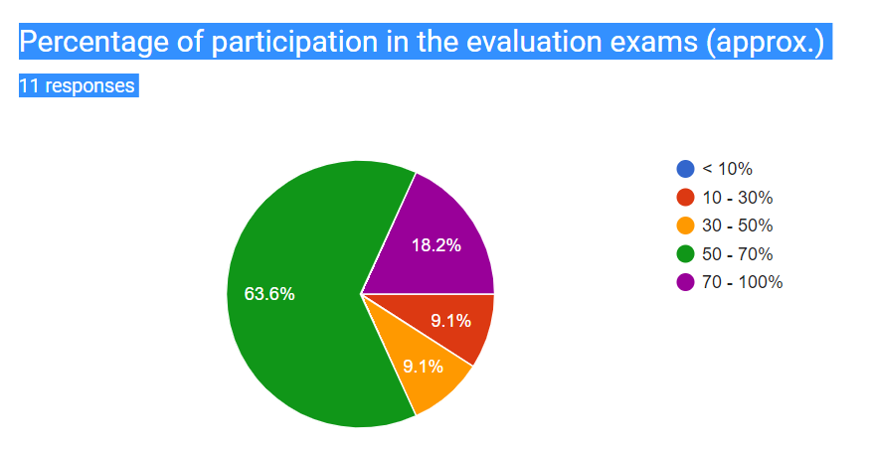
Deliverable 3.2

Slide 51
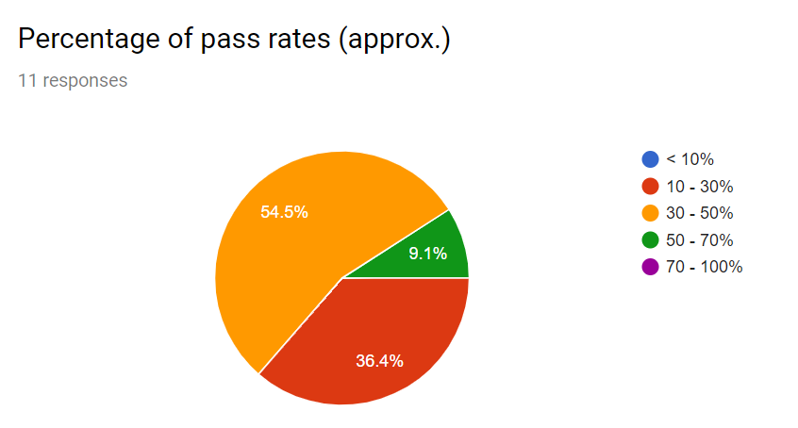
Deliverable 3.2

Slide 52
Deliverable 3.2
In case of low pass rates (question above) please indicate possible reasons:
Low Attendance of the lecture sessions
Lack of prior knowledge and of motivation

Slide 53
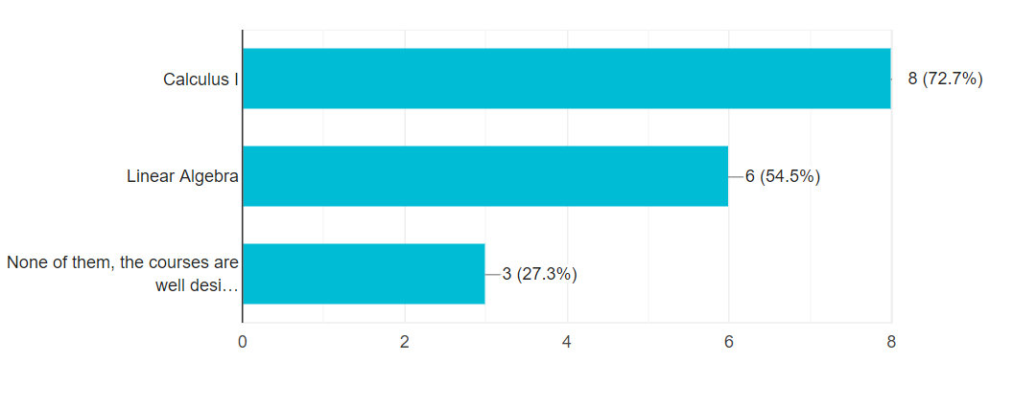
Deliverable 3.2
Judging from your experience, which courses do you think should be updated?

Slide 54
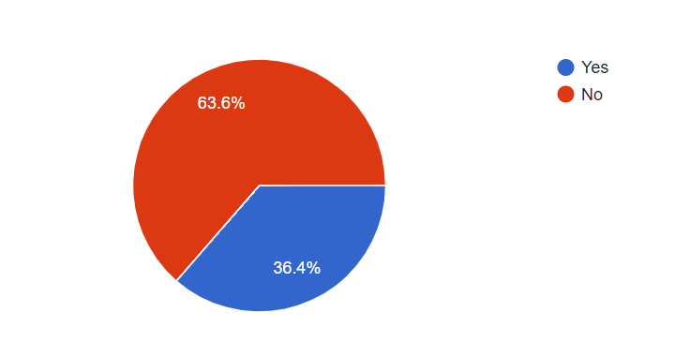
Deliverable 3.2
Judging from your experience, do you believe that the teaching hours are sufficient, considering both the material covered and the students' comprehension?

Slide 55
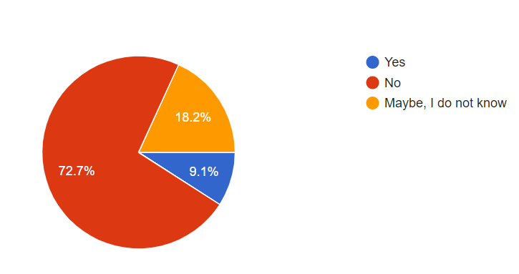
Deliverable 3.2
Is there any system of “identification" weak performance students in your institution?

Slide 56
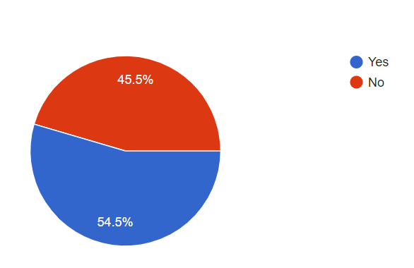
Deliverable 3.2
Do you relate your teaching with examples from science/engineering or even everyday life?

Slide 57
Deliverable 3.2
If you answered "yes" in the question above, please give below brief descriptions of the examples you use
Hyperbolic functions: electric cables - Matrices: Video games - Differential and Integral Calculus: Movement simulation
In the matrices, we use "transport task" as an example
i.e. matrices used for Zero forcing equalizers calculations in order to reduce Inter Symbol Interference
economies fluctuating, cars acceleration, determining the amount of materials needed for the construction of buildings, calculating the minimum costs

Slide 58
Deliverable 3.2
Please provide below a brief description of the difficulties/problems you faced during teaching these courses
Students believe that engineers do not need mathematics. They discover that it is wrong when they study for their thesis
Low attendance, no interest – low motivation
We don't give exercises for solutions and projects to the students
We are lack of programming and it is difficult to show and explain them the mathematical tasks in visual vision and practical courses

Slide 59
Deliverable 3.2
Please provide below a brief description of the difficulties/problems you faced during teaching these courses
Relation of the teaching with examples from science/engineering or even everyday life
Students are distracted from their mobile phones
We don't give exercises for solutions and projects to the students
Students have very poor mathematical pre-knowledge

Slide 60
Deliverable 3.2
Please provide below a brief description of the difficulties/problems you faced during teaching these courses
Few are the students who see that the basic mathematics courses are the most important tool in their studies. Most of them believe that such courses are a waste of time and effort and are put by the teachers as a form of punishment. There is very low interest in basic mathematics. A basic problem we face in my department is that our first year students who attend the classes come from two different mathematical backgrounds, one with sufficient tools to continue to advanced mathematics and the other with no basic maths tools at all. We are forced to start our teaching from pre -basic level which is bad for both groups (the lower-level group always believes that they are never going to reach the required mathematical knowledge and the higher-level group gets easily bored and looses interest).

Slide 61
Deliverable 3.2
Please share with us your ideas/suggestions that could improve the quality and effectiveness of basic mathematics in higher education
Of course giving examples from science and everyday life is going to greatly improve the teaching quality. To achieve this, more hours of mathematics are needed. The basic mathematics should be taught in more than two semesters. Also it is extremely important that these basic courses are prerequisite for other courses. This way the percentage of attendance and success rates will be increased
I believe that students have to learn for the first day of their higher education that engineers are ranked from their mathematics knowledge level.

Slide 62
Deliverable 3.2
Please share with us your ideas/suggestions that could improve the quality and effectiveness of basic mathematics in higher education
Interesting examples from real world, projects, less material per semester
More tutoring in small groups. Motivate students by making the course prerequisite for other courses. Compulsory midterm exam and homework
it is necessary to join mathematics with manufactory as this helps students understand more efficiently with practice and improve their knowledge about mathematics. For this aim, higher educations need some visual programs and practical equipment
To improve the quality and effectiveness of basic mathematics in elementary and high school education

Slide 63
Deliverable 3.3
Development of online testing that evaluate Student’s understanding before and after the iTEM tools application – 01/09/2021
The failure and success rates could be an indication of the difficulties and failures they experience right now
Also all the partners – test Institutions have provided samples of the exam papers
I suspect that (a) surveys; (b) middle term exams; (c) frequent exam testing; and (d) final exam success rates will show the success of iTEM tools
All the test Institutions should intensify their efforts to implement this task

Slide 64
Deliverable 3.4
Compose a report of findings from 3.1 – 3.3 – 01/09/2021
WIS is the responsible partner of this task

Slide 65
Deliverable 3.5
Quality of the iTEM’s management & collaboration – HMU & External Evaluator
HMU will run the 1st of these surveys (will be on six months base)
An external evaluator will be subcontracted to implement this task – Communication with the potential external evaluator will be established on the 19th of June 2019
The report will be in English

Slide 66
Deliverable 3.6
Evaluation of the generated material & videos (01/10/2021) – HMU & External Evaluator
An online questionnaire will be generated

Slide 67
Deliverable 3.7
Evaluation of the application of the PBL and POBL in the testing Institutions (01/10/2021) – External Evaluator & AAU
Tools to be employed: Questionnaires, evaluation of test results
Stakeholders: Students and Academics
Compose a report

Slide 68
Deliverable 3.8
Impact of Mobile Educational Tools & Simulations on Students’ Understanding and Motivation to learn Mathematics (01/10/2021) – External Evaluator & ULL
Tools to be employed: Questionnaires, evaluation of test results
Stakeholders: Students and Academics
Compose a report

Slide 69
Deliverable 3.9
Effectiveness of the tracking software (01/10/2021) – External Evaluator & UMIT
Tools to be employed: Questionnaires, evaluation of test results
Stakeholders: Students and Academics
Compose a report

Slide 70
Deliverable 3.10-11
Evaluation of the impact of the organised training events (01/10/2021) – External Evaluator & HMU
Tools to be employed: Questionnaires, evaluation of test results
Stakeholders: Students and Academics
Compose a report

Slide 71
Deliverable 3.10-11
Evaluation of the impact of the website & social media pages (01/10/2021) – External Evaluator & HMU
Tools to be employed: Questionnaires, evaluation of test results
Stakeholders: Students and Academics
Compose a report

Slide 72
Deliverable 3.12
Evaluation of the assessment visits at the end of the 1st and 2nd pilot phase (01/10/2021) – External Evaluator & WIS/AAU/UMIT/CVUT/KSU
Tools to be employed: Questionnaires, evaluation of test results
Stakeholders: Students and Academics
Compose a report

Slide 73
Work Package Four: Dissemination & Exploitation Plan Leading Partners: University of Mitrovica (Kosovo)

Slide 74
Deliverable 4.1
Deliverable Dissemination & Exploitation Plan: Its construction has started. It is expected to be ready by the end of August 2019 – (HMU & UMIB responsible partner) (31/08/2019)
A supporting Document (Excel Sheet) has been generated (shared in one drive) to register all the dissemination activities the partners have taken to inform the stakeholders for the project (HMU Responsible Partner)
Discussions how to exploit the vast network of Associated Partners should be initiated in the meeting and concrete conclusions to be taken (ULL responsible partner)

Slide 75
Deliverable 4.2
Deliverable 4.2: iTEM Website, Webpages & Social Media Pages (HMU & Subcontractor)
The iTEM website has launched and get updated everyday – please check: http://item.chania.teicrete.gr
The iTEM facebook page exists and updated – please join us, check here: https://www.facebook.com/groups/428028164793735/?epa=SEARCH_BOX
The iTEM Twitter page should be established – I need a volunteer
Weblinks within your IROs and your Departments should be created with links to the main webpage that disseminate iTEM in your language (and in English)

Slide 76
Deliverable 4.3
Deliverable 4.3: Printable Dissemination Material (HMU & Subcontractor)
The iTEM poster is available and uploaded into the one drive shared folders
The iTEM banner is available and uploaded into the one drive shared folders
The iTEM leaflet should be designed and be translated into all the languages of the consortium
All the dissemination material can be downloaded from the online document store of the website

Slide 77
Deliverable 4.4
Deliverable 4.4: E-NewsLetter (HMU & Subcontractor)
The 1st edition announced the objectives of the iTEM project – can be downloaded from the website or can be accessed from the following link: https://us20.admin.mailchimp.com/templates/share-template?id=15723
The 2nd newsletter will be generated after the event in AAU – Training School for Teachers in PBL (October 2019)

Slide 78
Deliverable 4.5
Deliverable 4.5: Publications in International Educational Events (HMU & Subcontractor)
The 1st Conference Paper – Poster Presentation is a reality. Prof. Rodriguo Gonsalez from ULL will present the project in the 9th International Congress on Industrial and Applied Mathematics - ICIAM 2019 / iTEM Poster Presentation, Valencia Spain

Slide 79
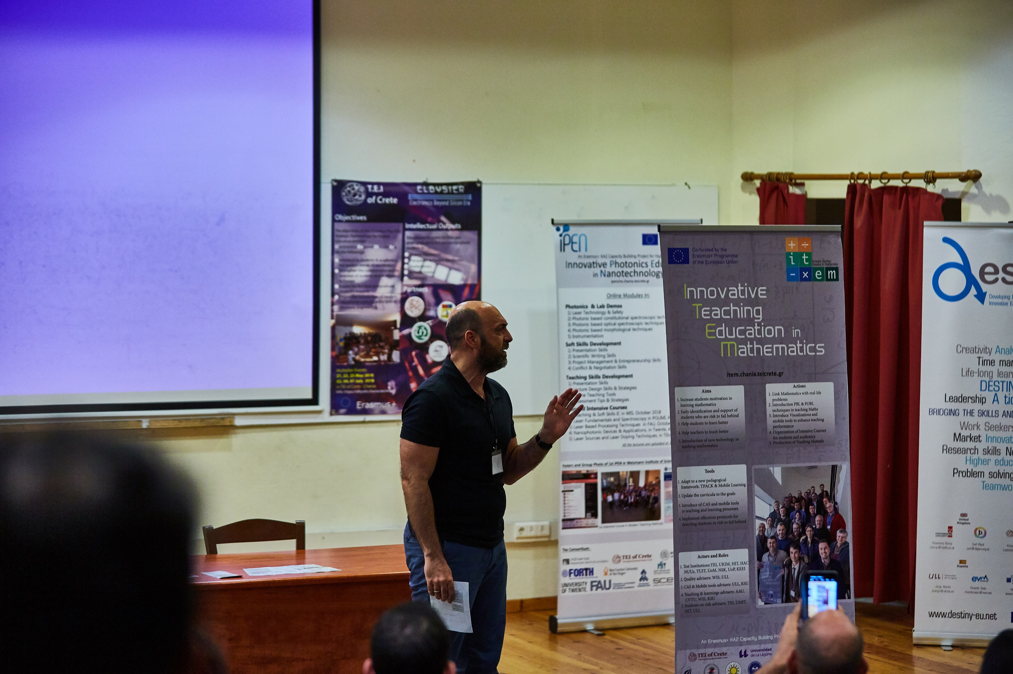
Deliverable 4.6
Deliverable 4.6: Erasmus Weeks within the consortium (HMU & Subcontractor)
The 1st Erasmus Week where the iTEM project was presented twice from Dr. Nissim Harel and Dr. Konstantinos Petridis took place in Crete (6th Erasmus Week) from the 20th to the 25th of May 2019
Please inform us about Erasmus Week taking place to participate and disseminate the project; the next one will take place in HIT – Nissim will inform us!!

Slide 80
Work Package Five: Management Leading Partners: Hellenic Mediterranean University (Greece)

Slide 81
Workpackage WP5

Slide 82
Deliverables 5.1/5.2
Deliverable 5.1: The Consortium Agreement
The task has been accomplished
Deliverable 5.2: The Project Manual
Consists from the EU Manual ‘How to use this grant’
EACEA Presentations for Dissemination, Finance Management
Coordinator’s Presentations

Slide 83
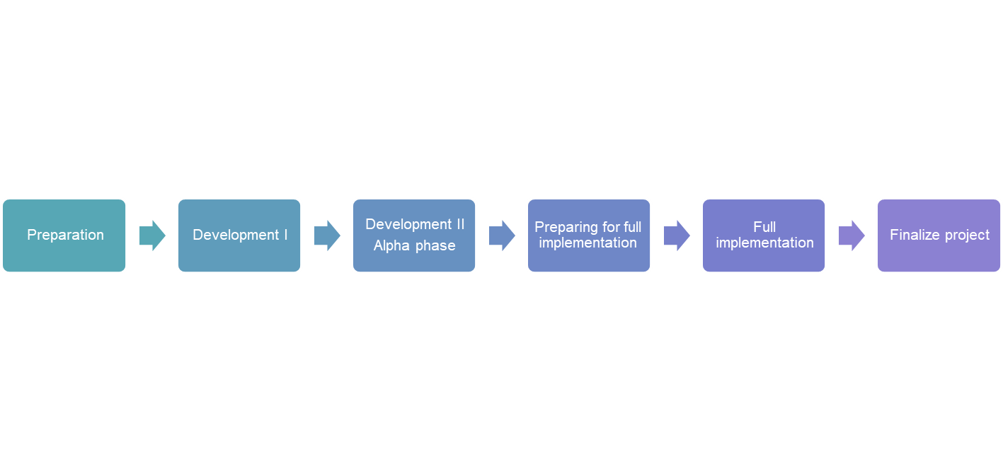
Deliverables 5.3
Deliverable 5.3: Project’s Timeline

Slide 84
Deliverables 5.3
Deliverable 5.3: Project’s Timeline

Slide 85
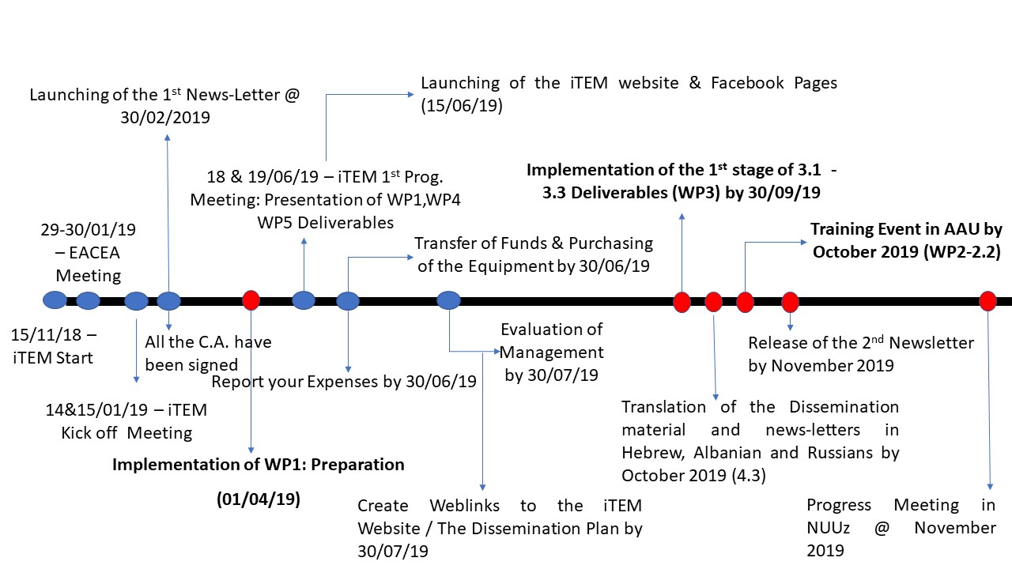
Deliverables 5.3
Deliverable 5.3: Project’s Timeline
The timeline for the actions to take place by the November 2019 is:

Slide 86
Deliverables 5.4
Deliverable 5.4: Internal Reporting
The internal reporting of the dissemination actions will be based on the excel sheet constructed
The expenses occurred should be reported on six months base. The excel sheet has been uploaded onto the one drive
Supporting Documents should be provided: timesheets, contracts, daily rates, travel supporting documents

Slide 87
Deliverables 5.5
Deliverable 5.5: Progress and Final Report
Progress Report by April 2020
Final Report by February 2021
Objective: to get prepared every six months like we have to submit the reports
Zero deviation from the submitted plan; any deviations request the permission of the PO

Slide 88
Deliverables 5.6
Deliverable 5.6: Auditors
They auditors (Grant Thorton) will be engaged since this October 2019
During the six months reporting of your financial expensed will be checked by them

Slide 89
Next Progress Meeting & Meeting Evaluation Leading Partners: Hellenic Mediterranean University (Greece)

Slide 90
Next Action
Training School for Teachers in Copenhagen, Aalborg University @ October 2019
Two days course
Three Academic Participants from the Test Institutions
Lecturers to come from the AAU, CVUT, KSU, ULL and WIS (two lecturers per partner)
Objectives: PBL, POBL, Evaluation Strategies, ICT & CAS tools in Math Training and Visualizations using Mathematica

Slide 91
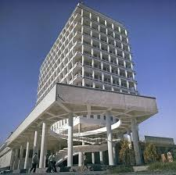
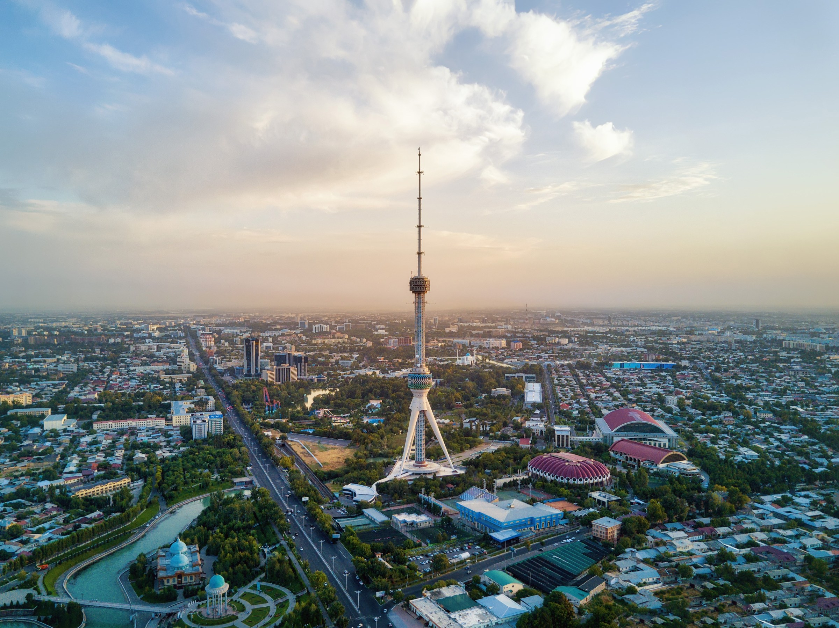
Next Progress Meeting
At Tashkent, Uzbekistan at NUUz at December 2019

Slide 92
Topics to Present in NUUz
Results extracted from the measurement of the baseline knowledge of Mathematics (Students) (MMU)
Presentation of the teaching material with the real life problems integrated into their curricula (HIT)
Presentation of the Teaching Guide (UMIT)
Presentation of the Visualizations (UMIB)

Slide 93
Topics to Present in NUUz
Presentation of the tools to identify students fall back in learning Mathematics – (UKIM)
The iTEM Moodle Platform (UKIM)
Presentation of the Teaching Guide (UMIT)
Presentation of the Manual to Students How to Learn Maths (CVUT)
Presentation of the Material for Students to use to come back (HMU)

Slide 94
Topics to Present in NUUz
Methodology and Facilities to follow and have to support students who fell back – (CVUT)

Slide 95
Meting Evaluation
Please follow the link:
https://forms.gle/AwZ9H6vRzkE3ctRZ9
Or scan the QR

